Slide 1
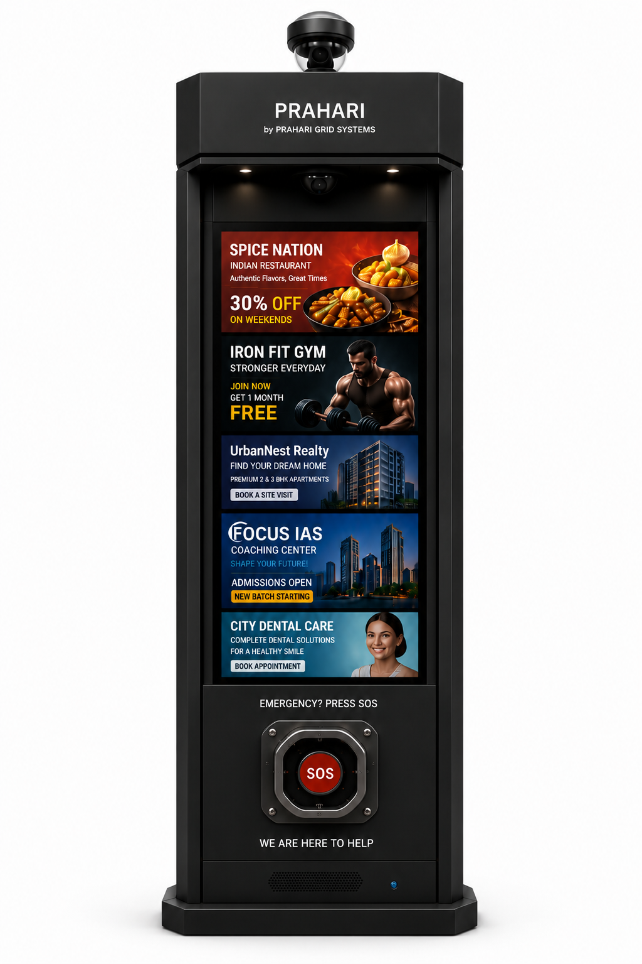

PRAHARI
Smart Public Infrastructure
for Urban India
prahari-official.vercel.app

Slide 2



PRAHARI GRID SYSTEMS
02
THE CHALLENGE
THE SOLUTION
Public Spaces
Deserve Better.
One Intelligent
Infrastructure Pillar.
PRAHARI turns every public space into a productive, connected, and safe environment. It generates advertising value during the day and delivers emergency infrastructure whenever it is needed.
No Emergency Access
Citizens in danger have no visible, physical way to reach help in a public emergency.
Why PRAHARI Works
Disconnected Spaces
• Advertising revenue funds public safety, with no public expenditure required
Public environments lack the connected infrastructure needed for real-time safety and response.
• Citizens get visible, accessible emergency access every hour of the day
Untapped Urban Assets
• Cities gain real-time monitoring and direct communication with the public
Street furniture sits idle, generating no civic value and no safety benefit for the community.
• Local businesses get affordable, hyperlocal outdoor advertising
prahari-official.vercel.app vasudeepkohli@gmail.com +91 77809 87246

Slide 3








PRAHARI GRID SYSTEMS
03
MEET PRAHARI
Engineered for Urban India.
360 Degree Surveillance
Emergency SOS Button
Dome camera, continuous coverage
IP67 physical button, live operator
Smart Digital Display
Two-Way Communication
High-brightness outdoor screen
Live audio and video to responders
Public Announcements
All-Weather Design
Wide-area broadcast capability
Built for continuous outdoor use
Remote Monitoring
4G and WiFi Connected
Cloud dashboard, real-time control
Always-on cloud connectivity
prahari-official.vercel.app vasudeepkohli@gmail.com +91 77809 87246

Slide 4
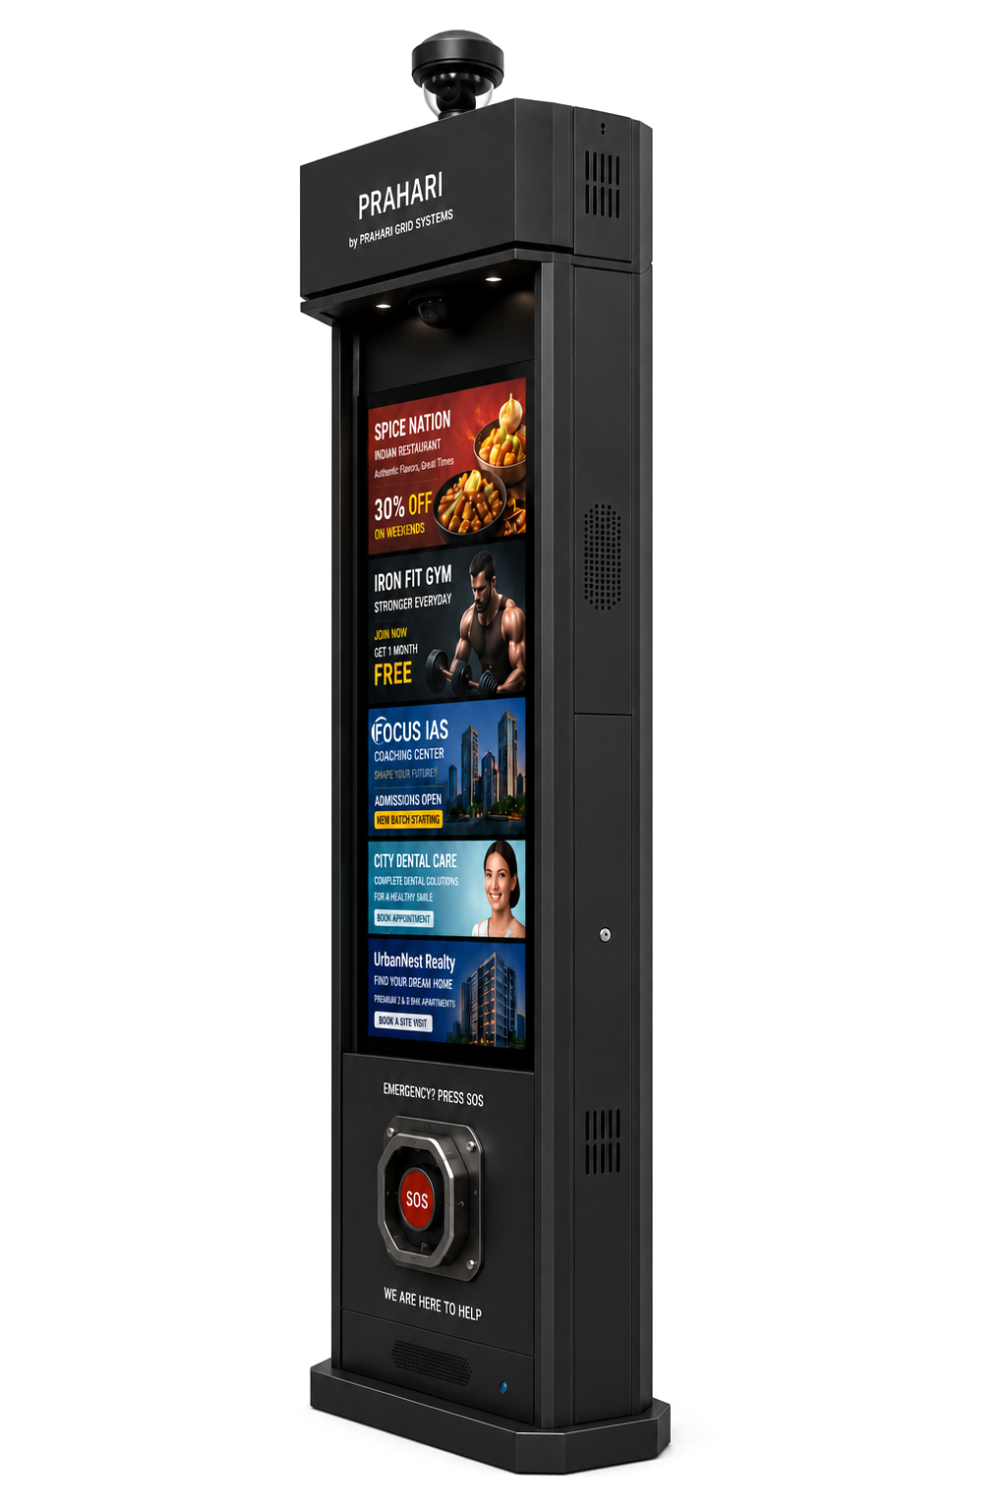


PRAHARI GRID SYSTEMS
04
ONE PLATFORM, TWO MODES
One Product. Two Operating Modes.
PRAHARI shifts seamlessly between commercial display and public safety infrastructure, on the same hardware, without interruption.
DAY MODE
NIGHT & EMERGENCY
Revenue & Utility
Safety Network
The display generates hyperlocal advertising revenue that funds the public safety network. No public budget required.
One press connects citizens directly to a live operator who can escalate to emergency services immediately.
Local Business Advertising
SOS Emergency Assistance
Community Messaging
Live Operator Communication
Public Information Displays
Public Safety Alerts
Hyperlocal Neighbourhood Reach
Authority Escalation & Response
prahari-official.vercel.app vasudeepkohli@gmail.com +91 77809 87246

Slide 5








PRAHARI GRID SYSTEMS
05
DEPLOYMENT ENVIRONMENTS
Engineered to Deploy
Across Every Public Setting.
DEPLOYMENT CATEGORIES
08
Public environment
types supported
From a single campus to a city-wide network, PRAHARI is planned around where people already gather.
PRIMARY DEPLOYMENT CONTEXTS
01
02
03
04
Smart Cities
Universities
Metro Stations
Airports
Municipal districts and smart city corridors
Campus grounds and student precincts
Platforms, concourses and station exits
Terminal entrances and car park zones
ADDITIONAL DEPLOYMENT CONTEXTS
Commercial Areas
Public Parks
Residential Hubs
Transport Hubs
High streets, markets and shopping centres
Open spaces, paths and recreation zones
Apartment complexes and gated communities
Bus stations and intermodal interchanges
Together, let us build safer, smarter, and more connected cities.

Slide 6
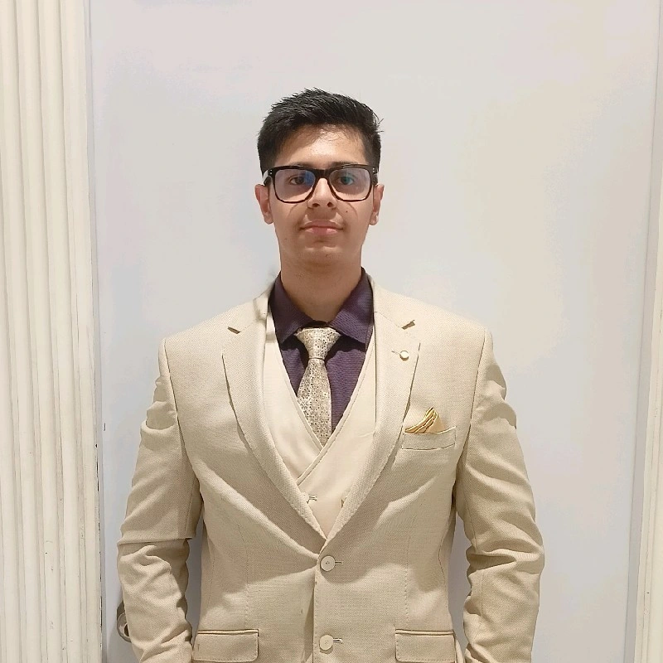





PRAHARI GRID SYSTEMS
06
FOUNDER AND VISION
GET IN TOUCH
Founder's Message
Partner with Us.
“I founded PRAHARI to solve two persistent urban challenges: immediate access to help during emergencies and affordable public visibility for local businesses. By combining both into one intelligent infrastructure platform, every deployment creates safer, smarter, and more connected public spaces.”
We welcome conversations with municipalities, smart city agencies, universities, commercial property owners, incubators, and strategic partners.
Website
prahari-official.vercel.app
Email
Vaasu Deep Kohli
vasudeepkohli@gmail.com
Phone
Founder & CEO
+91 77809 87246
PRAHARI Grid Systems
Our Mission
To build safer, smarter, and more connected public spaces through intelligent infrastructure, making emergency access a standard feature of every Indian city.
Website
Demo Video
prahari-official.vercel.app vasudeepkohli@gmail.com +91 77809 87246

